Slide 1


Macroeconomics
Ninth Edition
Chapter 10
Economic Growth, the Financial System, and Business Cycles
Copyright © 2025, 2021, & 2018 Pearson Education, Inc. All Rights Reserved
Notes:
If this PowerPoint presentation contains mathematical equations, you may need to check that your computer has the following installed:
1) MathType Plugin
2) Math Player (free versions available)
3) NVDA Reader (free versions available)

Slide 2
Chapter Outline
10.1 Long-Run Economic Growth
10.2 Saving, Investment, and the Financial System
10.3 The Business Cycle

Slide 3
Gen Z Experience the iPhone, Snapchat, … and a Pandemic
Gen Z is the segment of the population born between 1997 and 2012.
Gen Z has lived through the introduction of new goods and services resulting from the process of long-run economic growth.
But short-run fluctuations—like the Great Recession of 2007–2009—have also shaped their lives in important ways as many struggled to find jobs.
The Covid-19 pandemic also limited job prospects for new graduates.
You can see that both the long run and the short run affect people’s lives significantly.

Slide 4
Obtaining Economic Growth
We all want the United States to have a “strong” economy, since this will hopefully result in a better life for us and the people we care about.
What does it mean for the economy to be “strong” versus. “weak?”
In this chapter, we will explore what the concepts mean in the long term, and also in the short term.
We will also explore what sorts of things seem to lead to a stronger versus weaker economy.

Slide 5
10.1 Long-Run Economic Growth
Discuss the importance of long-run economic growth.
When we speak of long-run economic growth, we mean the process by which rising productivity increases the average standard of living.
This is in contrast to the short-run swings in the economy inherent to the business cycle, the alternating periods of economic expansion and economic recession.
The most commonly used measure of this average standard of living is real G D P per capita: The amount of production in the economy, per person, adjusted for changes in the price level.

Slide 6
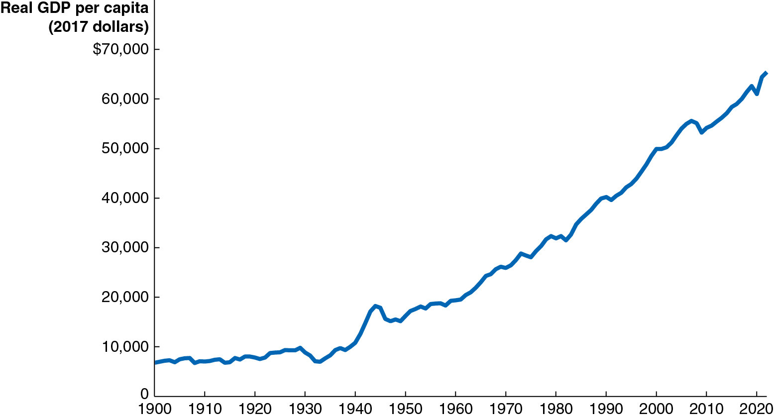
Figure 10.1 The Growth in Real G D P per Capita, 1900–2022
Real G D P per capita has risen more than nine-fold since 1900; the average American can buy more than nine times as many goods and services now as in 1900.
Notes:
NOTE: In the digital chapter, Figure 10.1 is an interactive real-time data graph, which means it automatically updates when new data becomes available.
The horizontal axis represents year, and ranges from 1900 to 2020, in increments of 10 years. The vertical axis represents real G D P per capita in 2017 dollars, and ranges from 0 to $70,000, in increments of 10,000. The line for growth in real G D P per capita rises from 6,764 in 1900, has some minor rises and falls, but consistently rises through 18,000 in 1945, 55,000 by 2018, and ends at 65,415 in 2022. All values are estimated.

Slide 7
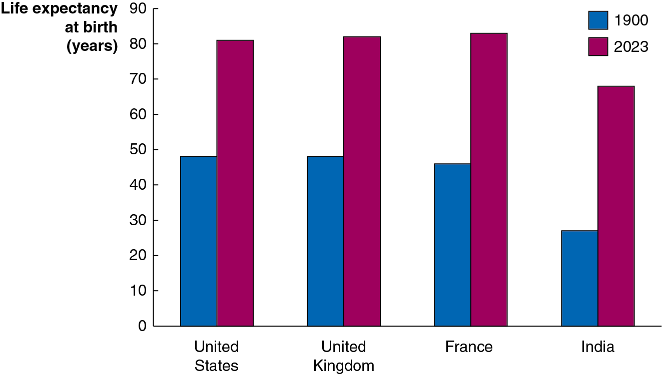
Apply the Concept: Economic Prosperity and Health (1 of 2)
Economic prosperity and health go hand in hand: richer nations can devote more resources to improving the health of their citizens, and healthier citizens are more productive.
While growth in real G D P per capita is an important measure of our improvement, another important measure is the increase in our lifespans. These have also increased markedly over the last century.
Notes:
The X axis represents country, and the Y axis represents life expectancy at birth, in years. Data for 1900 is labelled in blue, data for 2023 is labelled in red.
A bar chart has the following labels from left to right showing the life expectancies of four countries in 1900 and 2023. The values are;
United States in 1900 – 49 years and 79 years in 2023
United Kingdom in 1900 – 49 years and 80 years in 2023
France in 1900 – 48 years and 81 years in 2023
India in 1900 – 25 years and 70 years in 2023

Slide 8
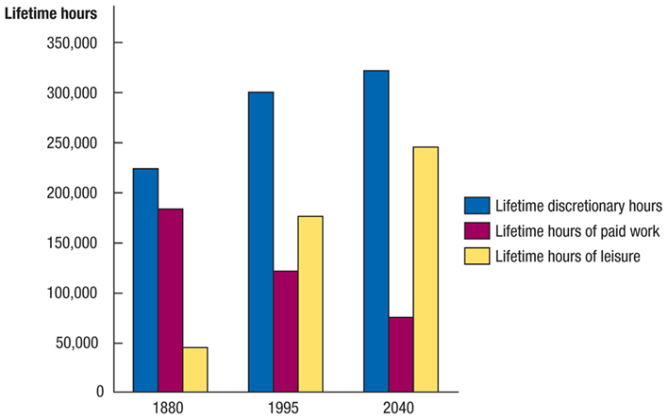
Apply the Concept: Economic Prosperity and Health (2 of 2)
Another good measure of our economic prosperity is the amount of time we can spend on leisure.
As our lifespan grows, we can spend more time on leisure; and also, as we grow more productive, we can devote less time to work, and hence more to leisure.
Nobel Prize-winner Robert Fogel predicts improvements will continue.
Notes:
The X axis represents year, and the Y axis represents lifetime hours. Data for lifetime discretionary hours are labelled in blue, data for lifetime hours of paid work are labelled in red, and data for lifetime hours of leisure are labelled in yellow.
1880
Lifetime discretionary hours = 225,000
Lifetime hours of paid work = 180,000
Lifetime hours of leisure = 49,000
1995
Lifetime discretionary hours = 300,000
Lifetime hours of paid work = 120,000
Lifetime hours of leisure = 170,000
2040
Lifetime discretionary hours = 330,000
Lifetime hours of paid work = 60,000
Lifetime hours of leisure = 250,000

Slide 9
Calculating Growth Rates
The growth rate of an economic variable like real G D P or real G D P per capita is equal to the percentage change from one year to the next.
In 2021, Real G D P was $21.4 trillion
In 2022, Real G D P was $21.8 trillion

Slide 10
Growth Rates over a Few Years
Over periods of a few years, we can average the growth rates to find the approximate annual rate of growth.
In 2020, real G D P growth was −2.2%
In 2021, real G D P growth was 5.8%
In 2022, real G D P growth was 1.9%
So, the average annual growth rate over this three-year period was;

Slide 11
Growth Rates over Longer Periods
For longer time periods, we wouldn’t want to calculate each of the annual growth rates and then take an average in order to find the average annual growth rate; instead we would solve for the growth rate g, where:
with t representing the number of time periods between the previous and current periods.
A useful shortcut called the Rule of 70 can help us determine how long it will take for an economic variable to double:
If the growth rate is 5 percent, the variable will double in

Slide 12
What Determines the Rate of Long-Run Growth?
Increases in real G D P per capita rely on increases in labor productivity: The quantity of goods and services that can be produced by one worker or by one hour of work.
Why can the average American consume more than nine times as many goods and services now than in 1900?
Because the average American produces more than nine times as many goods and services in an hour now than in 1900.
So, most of the answer to “what determines the rate of long-run growth?” is the same as the answer to “what determines labor productivity growth?”

Slide 13
Factors Affecting Labor Productivity Growth (1 of 2)
Increases in capital per hour worked
Capital is physical assets and intellectual property that are used to produce other goods and services.
The more capital a worker has available to use (including human capital, the accumulated knowledge and skills workers possess), the more productive he or she will be.
Technological change
Improvements in capital or methods to combine inputs into outputs (i.e., new technologies) allow workers to produce more in a given period of time.
The role of entrepreneurs here is critical in pioneering new ways to bring together the factors of production to produce better or lower-cost products.

Slide 14
Factors Affecting Labor Productivity Growth (2 of 2)
Property rights
A market system cannot function unless rights to private property are secure.
Governments can aid growth by establishing independent court systems to enforce contracts between private individuals.

Slide 15
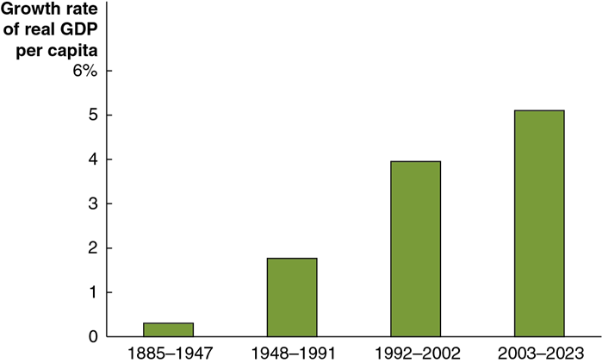
Apply the Concept: Can India Sustain Its Rapid Growth? (1 of 2)
To many people, the rapid economic rise of India was unexpected.
Before its independence from England in 1947, growth rates in India were very low, and India was desperately poor.
In 1991, the Indian government decided to scale back central planning, reduce regulations, and introduce market-based reforms, leading to the growth rate in India’s real G D P per capita doubling.
Notes:
The horizontal axis represents year. The vertical axis represents growth rate of real G D P per capita and ranges from 0 to 6%, in increments of 1%. The data from the bar graph is as follows.
1885 to 1947, 0.5%
1948 to 1991, 2%
1992 to 2002, 4%
2003 to 2019, 5.5%
All values are estimated.

Slide 16
Apply the Concept: Can India Sustain Its Rapid Growth? (2 of 2)
Continued growth will require upgraded infrastructure, improved educational and health services, and commitment to the rule of law and market-based reforms.
Recent key policies in India include:
Regulatory reforms to reduce corruption and improve the ability to operate businesses.
Modernizing infrastructure, including roads, railroads, and internet access.
Notes:
The horizontal axis represents year. The vertical axis represents growth rate of real G D P per capita and ranges from 0 to 6%, in increments of 1%. The data from the bar graph is as follows.
1885 to 1947, 0.5%
1948 to 1991, 2%
1992 to 2002, 4%
2003 to 2019, 5.5%
All values are estimated.

Slide 17
Potential G D P
Potential G D P is the level of real G D P attained when all firms are operating at capacity. Capacity here refers to “normal” hours and a “normal” sized workforce.
Potential G D P rises when the labor force expands, when a nation acquires more capital stock, or when new technologies are created.
The growth in potential G D P in the United States has been relatively steady at about 3.1 percent; that is, the potential to produce final goods and services has been growing in the United States at about this rate over time.
The recessions of 2007–2009 and 2020 resulted in a wider than usual gap between potential and actual G D P, as the next slide illustrates.

Slide 18
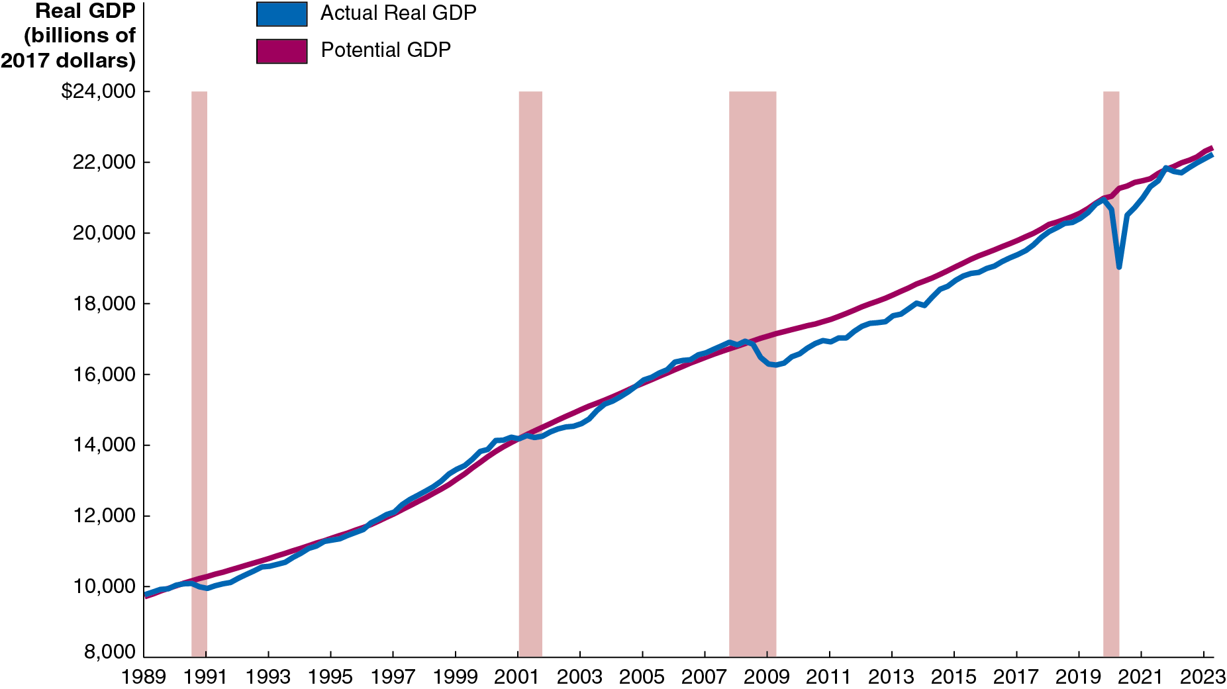
Figure 10.2 Actual and Potential G D P
Notes:
NOTE: In the digital chapter, Figure 10.2 is an interactive real-time data graph, which means it automatically updates when new data becomes available.
The horizontal axis represents year, and ranges from 1989 to 2023, in increments of 2 years. The vertical axis represents real G D P in billions of 2017 dollars, and ranges from 8,000 to $24,000, in increments of 2,000. The line for potential G D P starts at 9,950 in 1989, passes through 14,000 in 2000, and ends at 22,500 in 2023. The spans of recession, 1990 to 1991, 2001, 2007 to 2009, and 2020 are indicated as shaded areas. The actual real G D P rises and falls irregularly, but remains close to the smooth, consistently upward trending line for potential G D P. At the point of each recession, the actual real G D P dips down below potential G D P. The line for actual G D P starts at 9,950 in 1989, passes through 10,000 in 1990, 14,000 in 2000, 16,500 in 2008, 15,500 in 2009, 20,500 in 2019, 19,000 in 2020, and ends at 22,000 in 2023. All values are estimated.

Slide 19
10.2 Saving, Investment, and the Financial System
Discuss the role of the financial system in facilitating long-run economic growth.
Firms can finance some of their own expansion through retained earnings, reinvesting profits back into the firm.
But often firms want to obtain more funds for expansion than are available in this way.
Firms obtain these funds via the financial system: The system of financial markets and financial intermediaries through which firms acquire funds from households.

Slide 20
Financial Markets and Financial Intermediaries
Financial markets are markets where financial securities, such as stocks and bonds, are bought and sold.
Financial security: A document (sometimes electronic) stating the terms under which funds pass from the buyer of the security to the seller.
Stock: A financial security representing partial ownership of a firm.
Bond: A financial security promising to repay a fixed amount of funds. A bond is essentially a loan from a household to a firm.
Financial intermediaries are firms, such as banks, mutual funds, pension funds, and insurance companies, that borrow funds from savers and lend them to borrowers.

Slide 21
The Services the Financial System Provides
Risk sharing
By allowing investors to spread their money over many different assets, investors can reduce their risk while maintaining a high expected return on their investment.
Liquidity
The financial system allows savers to quickly convert their investments into cash.
Information
The prices of financial securities represent the beliefs of other investors and financial intermediaries about the future revenue stream from holding those securities.
This aggregation of information makes funds flow to the right firms.

Slide 22
The Macroeconomics of Savings and Investment
We will now derive the result that the total value of saving in the economy must equal the total value of investment.
Recall that we can express the G D P of a nation (Y) as the sum of consumption (C), investment (I), government purchases (G), and net exports (N X). That is,
We will assume a closed economy, with no exports or imports; so
We can rearrange this to obtain an expression for investment:
That is, investment in a closed economy is equal to income minus consumption and government purchases.

Slide 23
Savings
Savings is composed of private savings (by households,
and public savings (by the government,
is household income that is not spent; household income includes
payments for factors of production (Y) and transfer payments (T R); households consume (C) and pay taxes (T). So,
The government “saves” whatever it brings in but does not spend (this may be negative, known as dissaving):
So, total saving is:

Slide 24
Savings Equals Investment
The two previous slides led us to the same expressions for savings and investment. So we conclude that savings must equal investment:
When
is zero, the government spends as much as it
brings in; this is known as a balanced budget. Negative and
positive values for
are known as budget deficits and
budget surpluses, respectively.
Since the federal government funds its current deficits with borrowing (selling Treasury bonds), this takes away from the money available for investment spending.

Slide 25
The Market for Loanable Funds
If savings must equal investments, how exactly does this occur?
The financial system is composed of many different markets—the market for stocks, for bonds, for certificates of deposits at banks, etc.
A convenient way to model these is as a single market: the market for loanable funds, a (conceptual) interaction of borrowers and lenders that determines the market interest rate and the quantity of loanable funds exchanged.
For now, we will assume that interactions are only between domestic households and firms—there is no interaction with foreign lenders and borrowers.

Slide 26
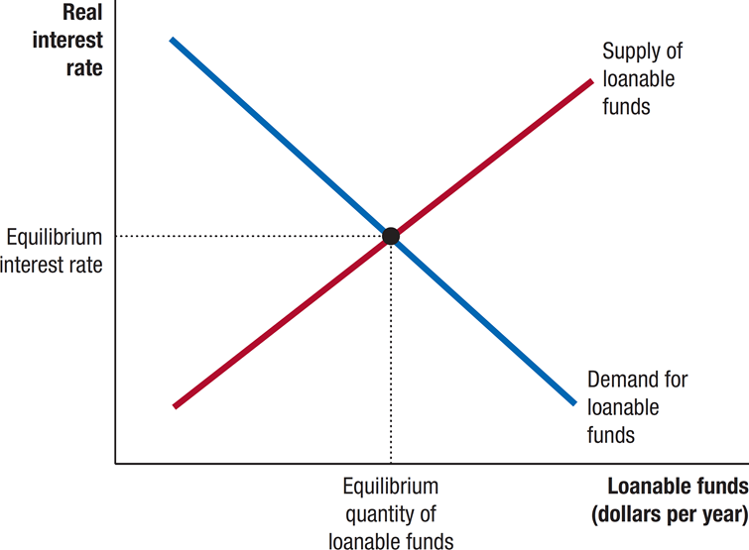
Figure 10.3 The Market for Loanable Funds
Firms borrow loanable funds from households. They borrow more when households demand a lower return on their money—a lower real interest rate.
Households supply loanable funds to firms. They provide more when firms offer them a greater reward for delaying consumption—a higher real interest rate.
Governments, through their saving or dissaving, affect the quantity of funds that “pass through” to firms.
Notes:
The X axis represents loanable funds in dollars per year, and the Y axis represents real interest rate. The supply of loanable funs, and demand for loanable funds intersect at (equilibrium quantity of loanable funds, equilibrium interest rate).

Slide 27
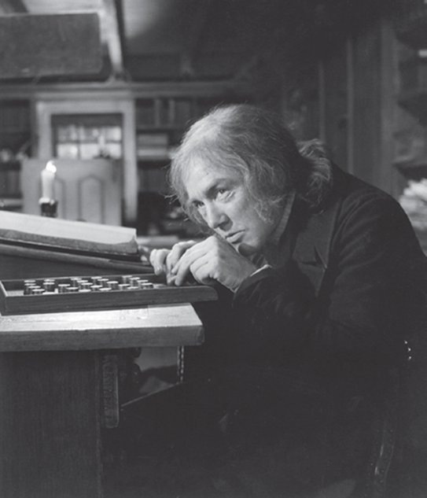
Apply the Concept: Ebenezer Scrooge: Accidental Promoter of Economic Growth?
In Charles Dickens’s A Christmas Carol, Ebenezer Scrooge initially spends little. In the book, this is portrayed negatively, but is this really fair?
By declining to consume, Scrooge elects to save. Society’s resources can then be set toward investment, increasing productive capacity and hence future consumption.
Eventually, Scrooge starts to spend his wealth. While this encourages current production, society was probably better served—and achieved stronger growth—when Scrooge chose to save instead.

Slide 28
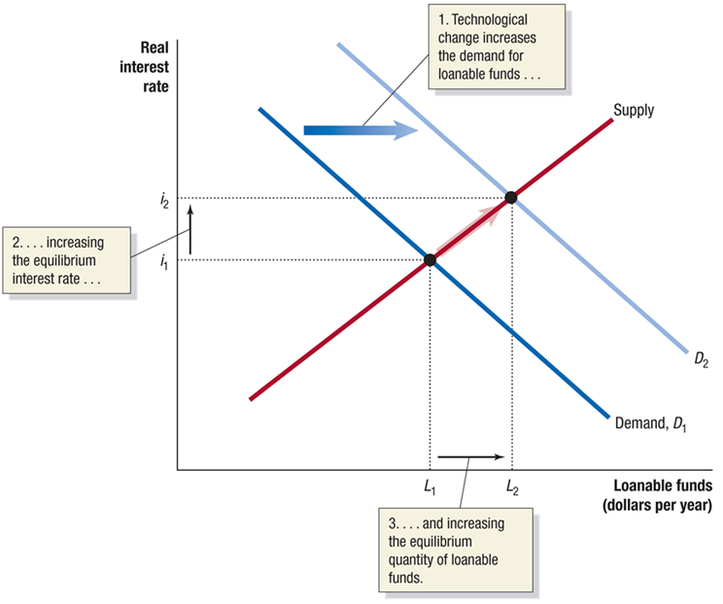
Figure 10.4 An Increase in the Demand for Loanable Funds
Suppose that technological change occurs so that investments become more profitable for firms.
This will increase the demand for loanable funds.
The real interest rate will rise, as will the quantity of funds loaned.
Notes:
The X axis represents loanable funds in dollars per year, and the Y axis represents real interest rate. Demand curve D sub 1 shifts right, and becomes D sub 2. Technological change increases the demand for loanable funds. The supply curve intersects D sub 1 at (L sub 1, I sub 1), and D sub 2 at (L sub 2, I sub 2). The distance between I sub 1 and I sub 2 is increasing the equilibrium interest rate, and the distance between L sub 1 and L sub 2 is increasing the equilibrium quantity of loanable funds.

Slide 29
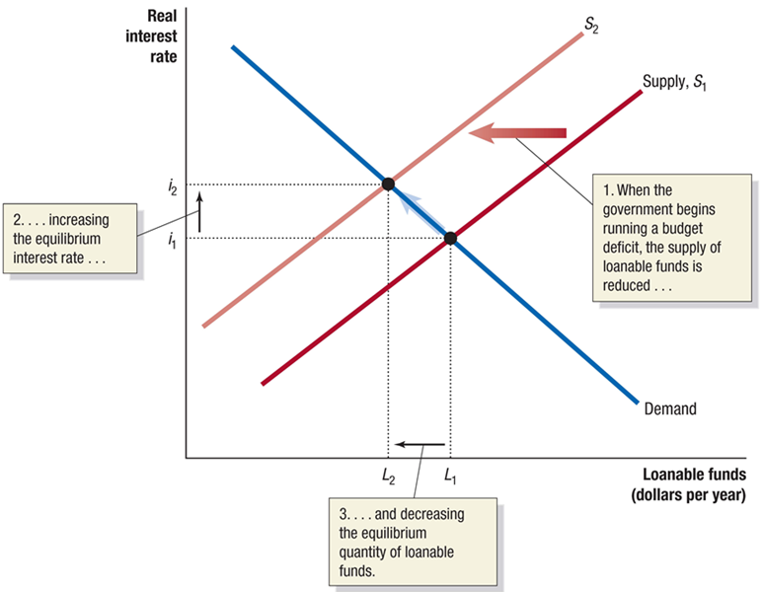
Figure 10.5 The Effect of a Budget Deficit on the Market for Loanable Funds
Suppose the government runs a budget deficit.
To fund the deficit, it sells bonds to households, decreasing the supply of funds available to firms.
This raises the equilibrium real interest rate and decreases the funds loaned to firms.
This is crowding out: a decline in private expenditure as a result of increases in government purchases.
Notes:
The X axis represents loanable funds in dollars per year, and the Y axis represents real interest rate. Supply curve S sub 1 shifts left and becomes S sub 2. When the government begins running a budget deficit, the supply of loanable funds is reduced. The demand curve intersects S sub 1 at (L sub 1, I sub 1), and S sub 2 at (L sub 2, I sub 2). The distance between I sub 1 and I sub 2 is increasing the equilibrium interest rate. The distance between L sub 1 and L sub 2 is decreasing the equilibrium quantity of loanable funds.

Slide 30
How Important Is Crowding Out?
In practice, the effect of government budget deficits and surpluses on the equilibrium interest rate is relatively small.
How small? According to one study, increasing borrowing by 1 percent of G D P would increase the real interest rate 0.003 points.
Why would the effect be so small?
Interest rates are influenced by global markets, so even a few hundred billion dollars is a relatively minor amount.

Slide 31
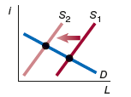
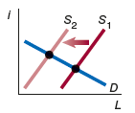
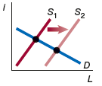
Table 10.1 Summary of the Loanable Funds Model (1 of 2)
An increase in … | will shift the … | causing … | Graph of the effect on equilibrium in the loanable funds market
the government’s budget deficit | supply of loanable funds curve to the left | the real interest rate to increase and investment to decrease. | A graph where the horizontal and vertical axes are labeled, L and i, respectively. S subscript 1 shifts left to become S subscript 2, intersecting the D line.
the desire of households to consume today | supply of loanable funds curve to the left | the real interest rate to increase and investment to decrease. | A graph where the horizontal and vertical axes are labeled, L and i, respectively. S subscript 1 shifts left to become S subscript 2, intersecting the D line.
tax benefits for saving, such as 401(k) retirement accounts, which increase the incentive to save | supply of loanable funds curve to the right | the real interest rate to decrease and investment to increase. | A graph where the horizontal and vertical axes are labeled, L and i, respectively. S subscript 1 shifts right to become S subscript 2, intersecting the D line.

Slide 32
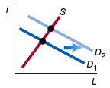
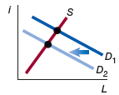
Table 10.1 Summary of the Loanable Funds Model (2 of 2)
An increase in … | will shift the … | causing … | Graph of the effect on equilibrium in the loanable funds market
expected future profits from new investments | demand for loanable funds curve to the right | the real interest rate and the level of investment to increase. | A graph where the horizontal and vertical axes are labeled, L and i, respectively. D subscript 1 shifts right to become D subscript 2, intersecting the S line.
corporate taxes | demand for loanable funds curve to the left | the real interest rate and the level of investment to decrease. | A graph where the horizontal and vertical axes are labeled, L and i, respectively. D subscript 1 shifts left to become D subscript 2, intersecting the S line.

Slide 33
10.3 The Business Cycle
Explain what happens during the business cycle.
While real G D P per capita has risen about nine-fold since the start of the twentieth century, it has not risen consistently every year.
Since at least the early nineteenth century, the American economy has experienced alternating periods of expanding and contracting economic activity.
These alternating periods are called the business cycle.

Slide 34
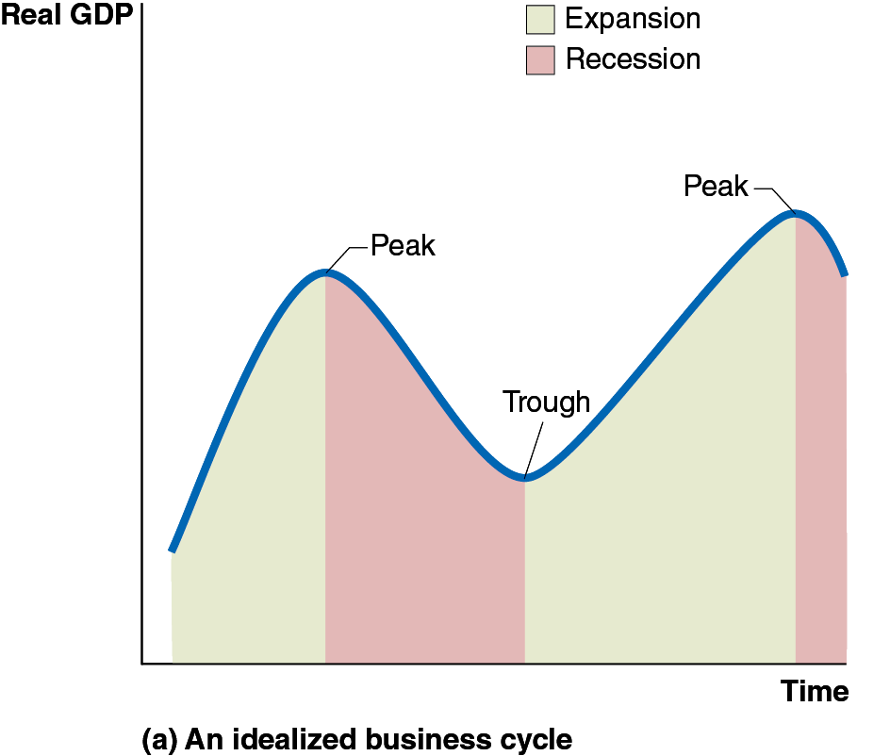
Figure 10.6 The Business Cycle (1 of 2)
The figure shows a typical idealized path for real G D P—rising, falling, then rising again.
The phases of rising are known as expansion; the periods of falling are recessions.
We refer to the points at which the economy changes from one phase to the other as peaks or troughs, respectively.
Notes:
(a) The graph represents an idealized business cycle. The horizontal axis represents time, and the vertical axis represents real G D P. The line for Real G D P rises and falls over a period of expansion, a recession, and a larger period of expansion, followed by a small period of recession. Expansion periods are shaded in green, and recession periods in red. At the point between the first expansion and recession, the real G D P line peaks, and at the end of the recession, the line falls to create a trough, before rising again steadily through the next expansion period to a peak and then falls slightly in the next recession.

Slide 35
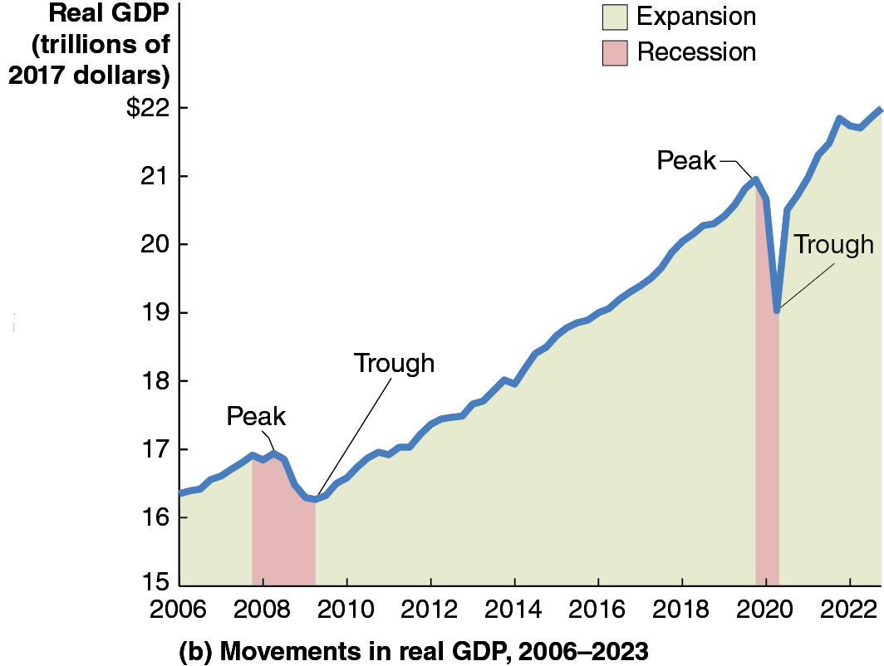
Figure 10.6 The Business Cycle (2 of 2)
This figure shows the movements in real G D P in the United States from 2006 to 2022.
The period of recession starting in late 2007 and ending in mid-2009 was the longest and most severe since the Great Depression of the 1930s, prompting some to refer to it as the Great Recession.
A short but severe recession occurred during the first months of the Covid-19 pandemic.
Notes:
The horizontal axis represents year, and the vertical axis represents real G D P in trillions of 2017 dollars. The line for Real G D P rises and falls over a period of expansion, a recession, and a larger period of expansion, followed by a small period of recession. Expansion periods are shaded in green, and recession periods in red. A small expansion period takes place before the recession between 2007 and 2009, followed by a large expansion period between 2009 and 2019, followed by a small recession period and in 2020, and an expansion period thereafter. The real G D P line is not smooth, and rises from 16.3 in 2006, to a peak of 16.8, between the first expansion and recession, the trough at 16.5 at the end of the recession, and a large peak gain to 20.7 by 2019, and a trough at 18.6 by 2020, and ends at 22 in 2023. All values are estimated.

Slide 36
Table 10.2 The U.S. Business Cycle Since 1950 (1 of 2)
How do we know when the economy is in a recession?
The federal government does not define when a recession starts or ends.
The typical media definition of a recession is “two consecutive quarters of declining real G D P.”
Peak | Trough | Length of Recession
July 1953 | May 1954 | 10 months
August 1957 | April 1958 | 8 months
April 1960 | February 1961 | 10 months
December 1969 | November 1970 | 11 months
November 1973 | March 1975 | 16 months
January 1980 | July 1980 | 6 months
July 1981 | November 1982 | 16 months
July 1990 | March 1991 | 8 months
March 2001 | November 2001 | 8 months
December 2007 | June 2009 | 18 months
February 2020 | April 2020 | 2 months
Source: National Bureau of Economic Research.

Slide 37
Table 10.2 The U.S. Business Cycle Since 1950 (2 of 2)
Most economists defer to the judgment of the National Bureau of Economic Research (N B E R):
“A recession is a significant decline in activity spread across the economy, lasting more than a few months, visible in industrial production, employment, real income, and wholesale-retail trade.”
Peak | Trough | Length of Recession
July 1953 | May 1954 | 10 months
August 1957 | April 1958 | 8 months
April 1960 | February 1961 | 10 months
December 1969 | November 1970 | 11 months
November 1973 | March 1975 | 16 months
January 1980 | July 1980 | 6 months
July 1981 | November 1982 | 16 months
July 1990 | March 1991 | 8 months
March 2001 | November 2001 | 8 months
December 2007 | June 2009 | 18 months
February 2020 | April 2020 | 2 months
Source: National Bureau of Economic Research.

Slide 38
What Happens during the Business Cycle?
While each business cycle is different, most share these features:
Near the end of an expansion, interest rates are rising, and the wages of workers are rising faster than other prices.
Firm profits are falling.
As a recession begins, firms decrease their investment spending, and households consume less.
Firms cut back on employment, leading to further declines in spending.
Eventually economic conditions improve; firms anticipate the future expansion and begin investing again.
Households do too, and eventually employment recovers.

Slide 39
The Effect of the Business Cycle on Inflation
The inflation rate measures the change in the price level from one year to the next.
During expansions, demand for products is high relative to supply, resulting in prices increasing—high inflation.
During recessions, demand for products is low relative to supply, resulting in prices increasing more slowly or even decreasing—low inflation or possibly deflation.
The graph on the next slide shows the movements in the (C P I) inflation rate over the last two decades.

Slide 40
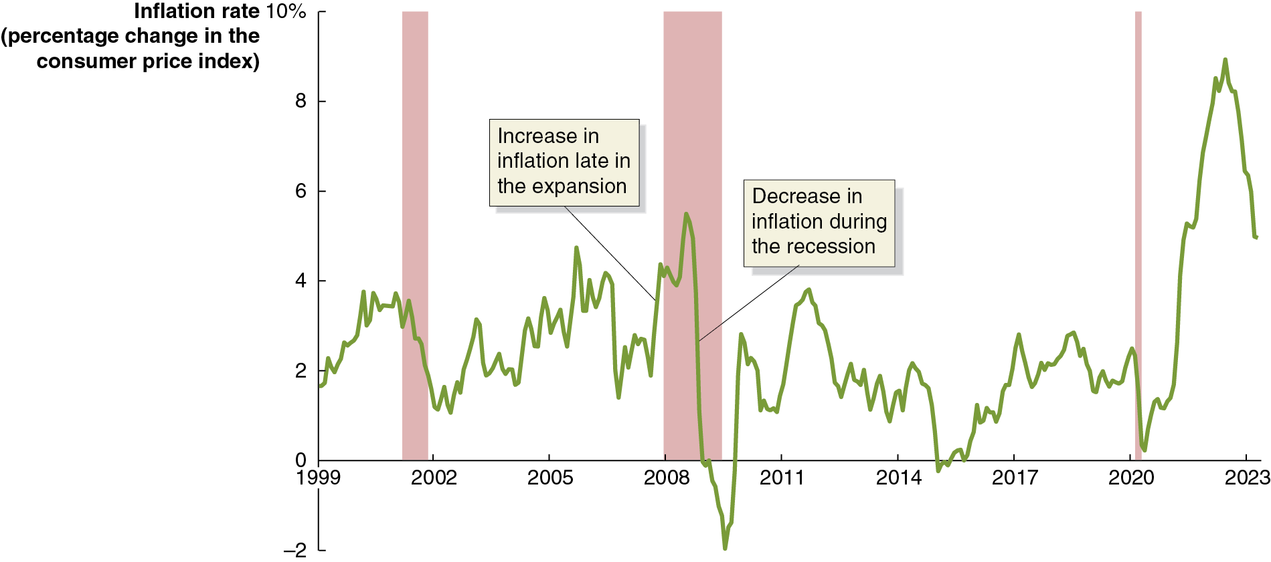
Figure 10.7 The Effect of Recessions on the Inflation Rate
Inflation tends to rise toward the end of an expansion and fall over the course of each recession.
Notes:
NOTE: In the digital chapter, Figure 10.7 is an interactive real-time data graph, which means it automatically updates when new data becomes available.
The horizontal axis represents year, and ranges from 1999 to 2023, in increments of 3 years. The vertical axis represents inflation rate in percentage change in the consumer price index, and ranges from negative 2 to 10%, in increments of 2%. Recession periods, 2001, 2007 to 2009, and 2020 are indicated as shaded areas. The line for the inflation rate has an irregular path across the graph. In each recession period, there is an increase in the inflation rate in the expansion, followed by a decrease in inflation during the recession. In 1999, the inflation rate is at 1.8. In 2001, the rate climbs to 3.8, and falls to 1 at the end of the period. The rate rises and falls between the 2007 to 2009 recession period, rising from 2 to 4.3, and then to 5.5 during the recession, and a fall to negative 2 by 2008. The rate then rises to the positive range after 2010 to 2.9, maintaining a mostly positive path from 2017 through 2019. The rate then falls close to zero in 2020, again rising to a peak of 9.7 in 2022 and then falls to 5 in 2023. All values are estimated.

Slide 41
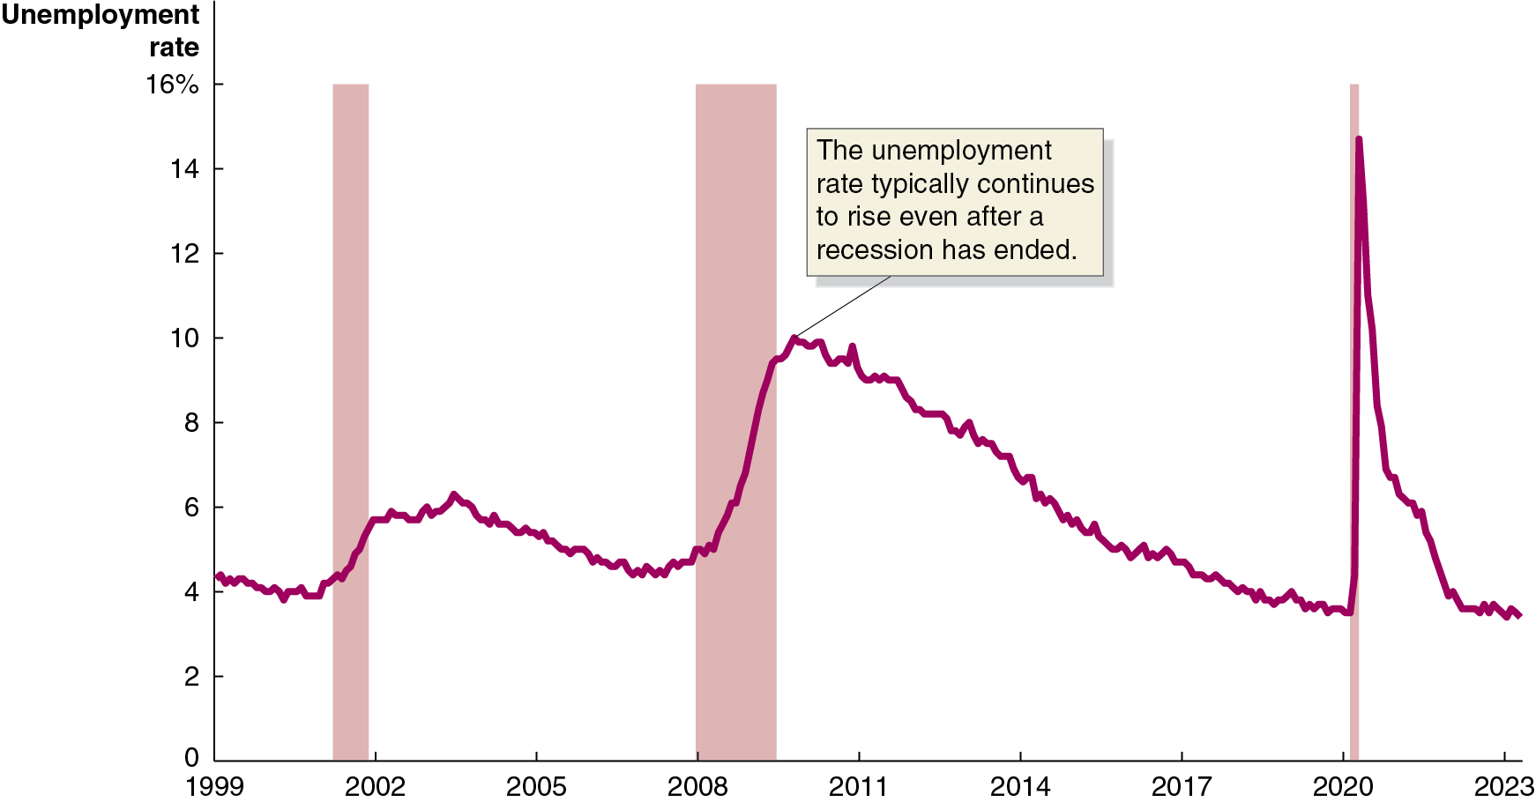
Figure 10.8 How Recessions Affect the Unemployment Rate
As firms see their sales start to fall in a recession, they generally reduce production and lay off workers.
Notice that unemployment often continues to rise after the end of each recession.
Notes:
NOTE: In the digital chapter, Figure 10.8 is an interactive real-time data graph, which means it automatically updates when new data becomes available.
The horizontal axis represents year, and ranges from 1999 to 2023, in increments of 3 years. The vertical axis represents unemployment rate, and ranges from 0 to 16% in increments of 2%. The 2001, 2007 to 2009, and 2020 recession periods are indicated as shaded area. The line for unemployment starts at 4.2 in 1999, passes through 6 in 2002, and 4.3 in 2008. During the recession period in 2007 to 2009, the unemployment rate typically continues to rise even after a recession has ended. The line passes through 10 in 2010, falls to 4 in 2020, again peaks to 15 in 2020, falls to 3.8 in 2022 and ends at 3.7 in 2023. All values are estimated.

Slide 42
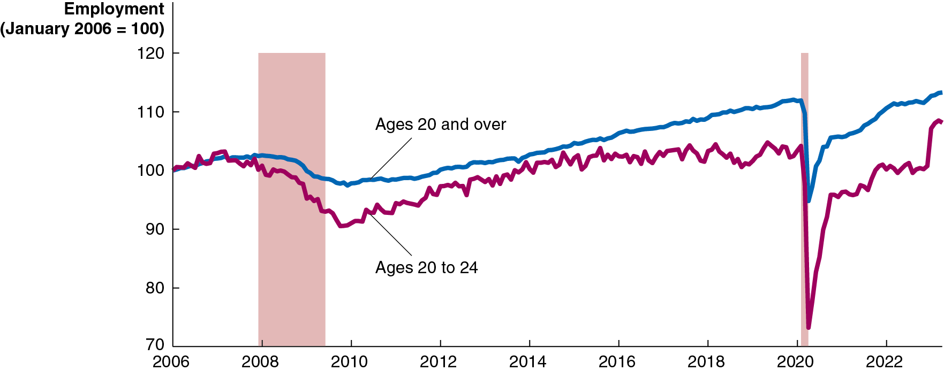
Figure 10.9 The Effect of the Great Recession and the 2020 Covid-19 Recession on Younger Workers
Younger millennials were hit especially hard by the Great Recession. Even now, those who were aged 20–24 in 2006 are less likely to be employed than older workers. They saw similar impacts during the Covid-19 recession of 2020.
Older millennials were also affected, but less dramatically.
Notes:
NOTE: In the digital chapter, Figure 10.9 is an interactive real-time data graph, which means it automatically updates when new data becomes available.
The horizontal axis represents year, and ranges from 2006 to 2022, in increments of 2 years. The vertical axis represents employment, January 2006 = 100, and ranges from 70 to 120, in increments of 10. The recession periods, 2007 to 2009 and 2020 are indicated as shaded areas. The lines for ages 20 and over begins at 100, rises to 102 prior to the recession, falls through the recession, and gradually rises to 112 in 2020, then falls to 95 by end of recession and then rises to 115 in 2023. The line for ages 20 to 24 has a similar pattern of growth, but is a more jagged line. Prior to the recession ages 20 to 24 fell from 102 to 90 by 2010, rose gradually, and then began to fluctuate around 100 by 2015. The line then fell to 72 in 2020, then rose to 97 in 2020, and ended at 108 in 2023. All values are estimated.

Slide 43

Apply the Concept: Why Can’t Economists Predict Recessions?
Queen Elizabeth
visited the
London School of Economics during the 2008 financial crisis, and asked “Why did nobody notice it?”
Why can’t economists predict recessions?
Business cycles are not uniform.
Leading economic indicators are not reliable.
Events that trigger a recession are hard to predict.

Slide 44
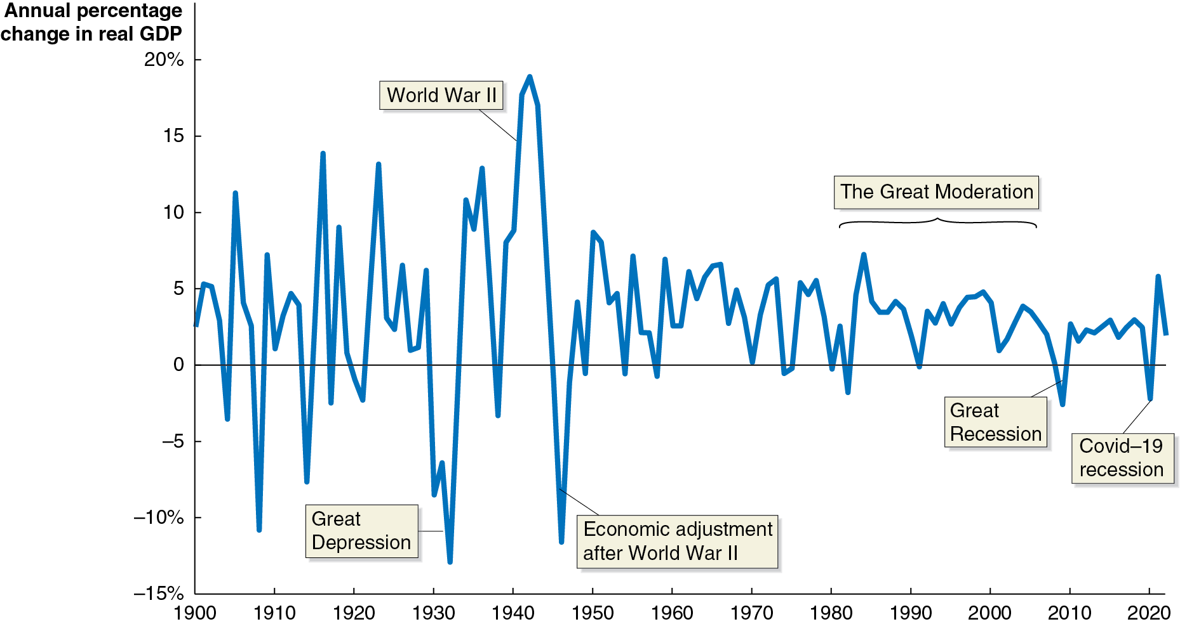
Figure 10.10 Fluctuations in Real G D P, 1900–2022
Annual fluctuations in real G D P were typically greater before 1950 than after 1950.
Business cycles have been particularly mild since the mid-1980s, with some economists calling the ensuing period the Great Moderation.
Notes:
The horizontal axis represents year, and ranges from 1900 to 2020, in increments of 10. The vertical axis represents annual percentage change in real G D P, and ranges from negative 15 to 20%, in increments of 5%. The line for annual percentage change in real G D P starts from 3% in 1900, rises and falls greatly between 1909 at 12% and 1950 at negative 1. Between 1950 and 2018, the changes rise and fall at much more contained values, mainly between 10 and 0, and ends at 4% in 2023. The annual percentage change in real G D P during major events include as follows. Negative 13% during Great Depression in 1930, 15% during World War II in 1940, negative 10% during Economic adjustment after World War II in 1945, 8% to 0% during the Great Moderation from 1980 to 2005, negative 3% during Great Recession in 2008, and negative 4% during Covid 19 recession in 2020. All values are estimated.

Slide 45
Table 10.3 Until 2007, the Business Cycle Had Become Milder
Period | Average Length of Expansions | Average Length of Recessions
1870–1900 | 26 months | 26 months
1900–1950 | 25 months | 19 months
1950–2007 | 61 months | 10 months
The length and severity of the recession of 2007–2009 made some economists and policymakers wonder if we would return to the previous pattern of long expansions and short, mild recessions.
But except for the Covid-19 recession in 2020 and the subsequent strong recovery, growth has been exceptionally stable.

Slide 46
Can the U.S. Economy Return to Stability?
Several factors help to explain the Great Moderation, and their continuation suggests the U.S. economy will return to stability:
The increasing importance of services
Manufacturing (especially of durable goods) is more strongly affected by recessions. The economy is based more on services now, decreasing the effect of the business cycle on G D P.
The establishment of unemployment insurance
Before the 1930s, unemployment insurance and other government transfer programs like Social Security did not exist. These programs increase the ability of consumers to purchase goods and services during recessions.

Slide 47
Explaining the Great Moderation
Several factors help to explain the Great Moderation, and their continuation suggests the U.S. economy will return to stability:
Active federal government stabilization policies
Many, though not all, economists believe that active government policies to lengthen expansions and minimize the effects of recessions have had the desired effect. The debate over the role of government in this way became particularly intense during the recession of 2007–2009.
Increased stability of the financial system
The severity of the Great Depression of the 1930s was in part caused by instability in the financial system; similar instability exacerbated the recession of 2007–2009. Returning to macroeconomic stability will require a stable financial system.

Slide 48

Copyright
This work is protected by United States copyright laws and is provided solely for the use of instructors in teaching their courses and assessing student learning. Dissemination or sale of any part of this work (including on the World Wide Web) will destroy the integrity of the work and is not permitted. The work and materials from it should never be made available to students except by instructors using the accompanying text in their classes. All recipients of this work are expected to abide by these restrictions and to honor the intended pedagogical purposes and the needs of other instructors who rely on these materials.

